Slide 1

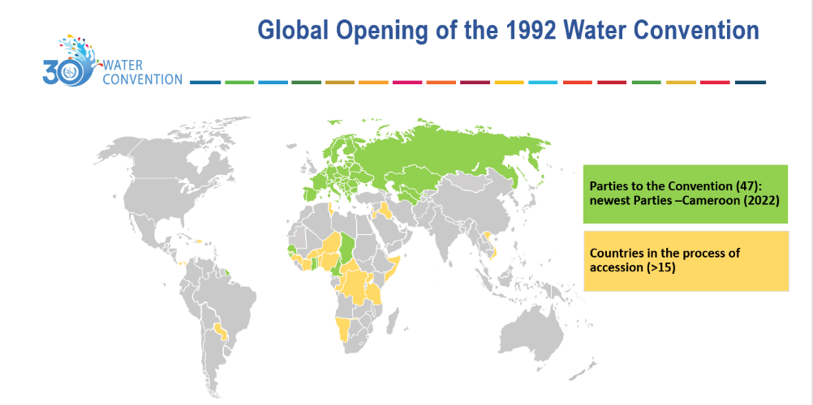
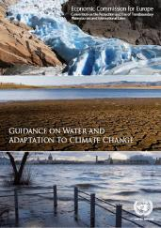
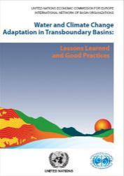
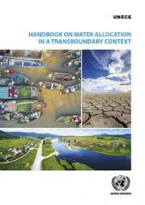
Water Convention
Unique global legal and intergovernmental framework on transboundary cooperation
Task Force on Water and Climate since 2006
Promoting water and climate in global processes
Regular global workshops
Guidance and publications on water and climate
https://unece.org/environment-policy/water/areas-work-convention/water-and-adaptation-climate-change
Contact: hanna.plotnykova@un.org

Slide 2
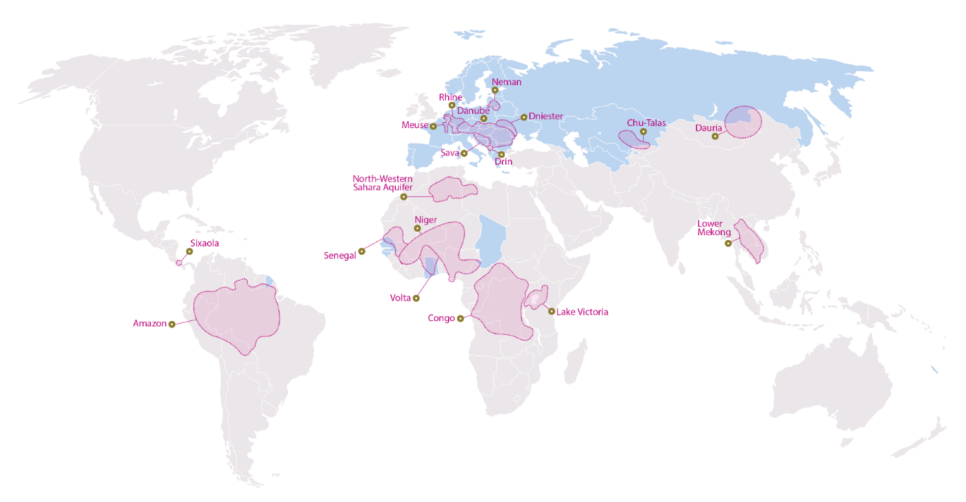


Global network of basins working on climate change adaptation (18 basins)
6th meeting of the Global network of basins working on climate change adaptation (25 April 2022)
Recent progress report
https://unece.org/sites/default/files/2022-04/Global_network_overview_pilot projects_progress_Apr2022_final_ENGL_update_0_1.pdf

Slide 3

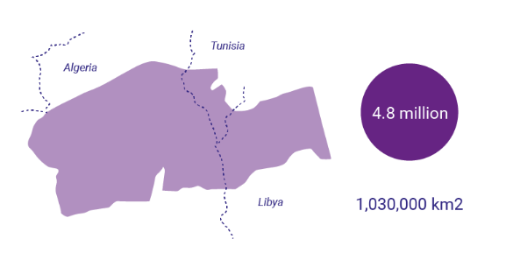
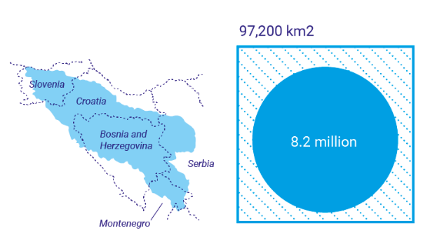
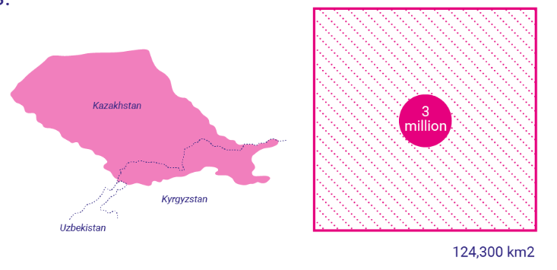
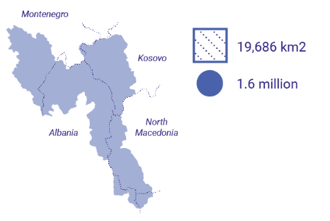
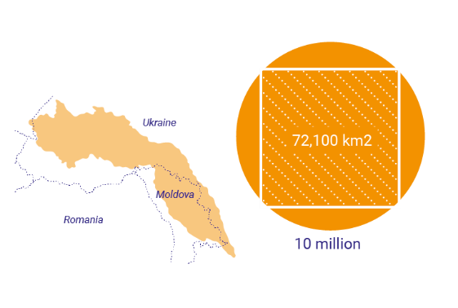
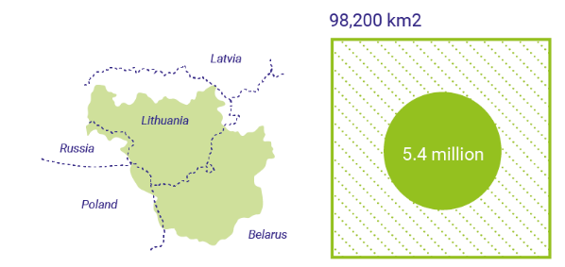
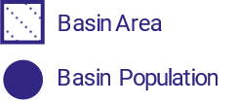
Option 1
Since the early 2000s, the Water Convention has supported building resilience for 33 million people across 6 basins:
North Western Sahara Aquifer
Drin
Sava
Chu-Talas
Neman
Dniester

Slide 4






The Water Convention supports countries through the 5 stages of the Climate Change Adaption process:
Climate Impacts, Vulnerability Assessments, Adaptation Strategies and Plans
Implementation of Adaptation Strategies and Plans
Joint bodies working on Climate Change Adaptation
Agreements / Treaties
Dialogues
Integration of Climate Change into River Basin and Flood Risk Management Plans
Improved transboundary cooperation
Climate Change resilience

